Slide 1

Anomaly Detection using Hidden Markov Models with Data Analysis CMPT 318 FOR DR. UWE GLASSER SFU FALL 2021
ALI ALDEN 301302901
MICHAEL VANDERVELDEN 301386669

Slide 2
Predicting the future isn’t magic, it’s artificial intelligence.
~Dave Waters.

Slide 3
Abstract
The purpose of this project is to investigate the use of hidden Markov models for anomaly detection.
We accomplished this with three key steps:
Feature engineering: employing principal component analysis to determine the optimal variable to use as training data.
Training and testing a hidden Markov model, implemented in R.
Using our model to find anomalies in the given datasets.
The model performed as expected, facilitating anomaly detection in all three given datasets.

Slide 4
Feature engineering
The main tool we employed to determine the best feature(s) for model training was principal component analysis (PCA)
The R function prcomp() from the stats library was instrumental in this analysis.

Slide 5
Importance of components
 | PC1 | PC2 | PC3 | PC4 | PC5 | PC6 | PC7
Standard deviation | 1.6911 | 0.9992 | 0.9698 | 0.9133 | 0.8777 | 0.68606 | 0.35513
Proportion of Variance | 0.4086 | 0.1426 | 0.1343 | 0.1192 | 0.1101 | 0.06724 | 0.01802
Cumulative Proportion | 0.4086 | 0.5512 | 0.6855 | 0.8047 | 0.9147 | 0.98198 | 1.00000

Slide 6
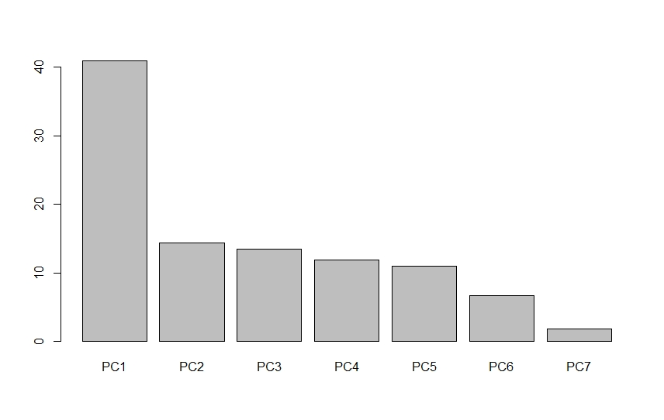
Importance of components
As shown in the table, principal component PC1 had the greatest impact on the data.
This is because PC1 accounts for more than 40% of variance in the data, as visualised above.

Slide 7
Importance of components
Features | PC1 | PC2 | PC3 | PC4 | PC5 | PC6 | PC7
Global_active_power | -0.46872 | 0.134757 | -0.08736 | -0.06854 | 0.261449 | -0.76918 | -0.29968
Global_reactive_power | -0.19475 | -0.74423 | 0.166002 | 0.60787 | 0.064466 | -0.0329 | -0.07678
Voltage | 0.330526 | -0.13246 | -0.03506 | -0.13266 | 0.919 | 0.081727 | 0.056028
Global_intensity | -0.5596 | 0.019129 | 0.001156 | -0.06409 | 0.138189 | 0.081176 | 0.810364
Sub_metering_1 | -0.29884 | -0.12875 | 0.728446 | -0.47839 | 0.042941 | 0.240646 | -0.27363
Sub_metering_2 | -0.28379 | -0.41294 | -0.65121 | -0.42742 | -0.05497 | 0.286867 | -0.23846

Slide 8
Importance of components
In the previous visual, the 6 potential features of our data are arranged with their respective principal components.
This analysis is on 6 month period between January 2010 and July 2010.
(CHANGE)

